Slide 1
Views in Rails

Slide 2
Appendix
Action View
Layout / Template
Render and partials
Rendering css and js
Routes
Object Binding / Form Helpers
Form_for
Form_tag
Rails fields / tags

Slide 3
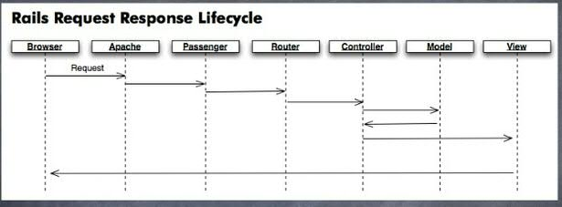
Action View
Action View and Action Controller are the two major components of Action Pack. In Rails, web requests are handled by Action Pack, which splits the work into a controller part (performing the logic) and a view part (rendering a template). Typically, Action Controller will be concerned with communicating with the database and performing CRUD actions where necessary. Action View is then responsible for compiling the response.

Slide 4
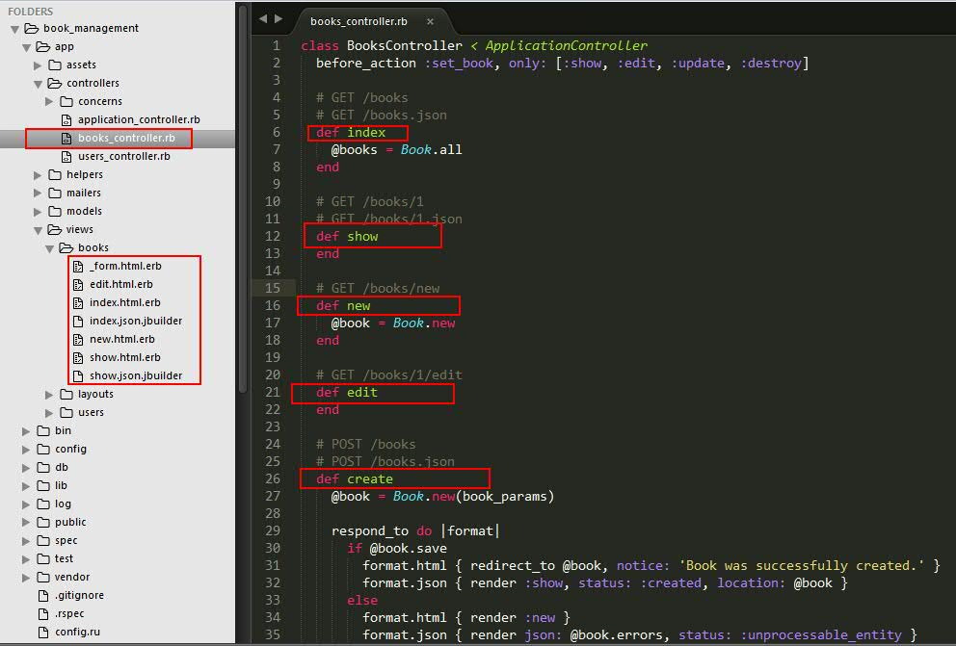
For each controller there is an associated directory in the app/views directory which holds the template files that make up the views associated with that controller. These files are used to display the view that results from each controller action.

Slide 5
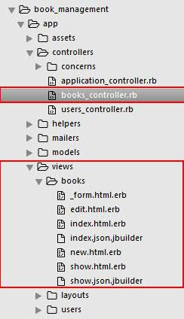
There is a naming convention for views in Rails.
Typically, the views share their name with the associated controller action, as you can see here. For example, the index controller action of the books_controller.rb will use the index.html.erb view file in the app/views/books directory.

Slide 6
Layout
The final HTML output is a composition of three Rails elements:
Templates,
Partials and
Layouts

Slide 7
Templates
HTML file using the ERB template system will have .html.erb as a file extension Within an ERB template, Ruby code can be included using both <% %> and <%= %> tags.
The <% %> tags are used to execute Ruby code that does not return anything, such as conditions, loops or blocks, and the <%= %> tags are used when you want output.
Consider the following loop for books:
<h1>Names of all the books</h1>
<% @books.each do |book| %>
Name: <%= book.name %><br>
<% end %>

Slide 8
Render and partials
Partial templates - usually just called "partials" - are another device for breaking the rendering process into more manageable chunks. With partials, you can extract pieces of code from your templates to separate files and also reuse them throughout your templates.
To render a partial as part of a view, you use the render method within the view:
<%= render 'form' %>
This will render a file named _form.html.erb at that point within the view that is being rendered.
Note : the leading underscore character: partials are named with a leading underscore to distinguish them from regular views, even though they are referred to without the underscore. This holds true even when you're pulling in a partial from another folder:
<%= render "shared/form" %>
That code will pull in the partial from app/views/shared/_form.html.erb.

Slide 9
Using Partials to simplify Views
One way to use partials is to treat them as the equivalent of subroutines; a way to move details out of a view so that you can grasp what's going on more easily. For example, you might have a view that looks like this:
Example
<%= render "shared/ad_banner" %>
<h1>Books</h1>
<p>Here are a few of our fine Books:</p>
<% @books.each do |book| %>
<%= render partial: “book", locals: {book: book} %>
<% end %>
<%= render "shared/footer" %>

Slide 10
Rendering Collections
It is very common that a template will need to iterate over a collection and render a sub-template for each of the elements. This pattern has been implemented as a single method that accepts an array and renders a partial for each one of the elements in the array.
So this example for rendering all the books:
<% @products.each do |product| %>
<%= render partial: "product", locals: { product: product } %>
<% end %>

Slide 11
Partial Layouts
Partials can have their own layouts applied to them. These layouts are different from those applied to a controller action, but they work in a similar fashion.
Let's say we're displaying an article on a page which should be wrapped in a div for display purposes. Firstly, we'll create a new Article:
Article.create(body: 'Partial Layouts are cool!')
In the show template, we'll render the _article partial wrapped in the box layout:
articles/show.html.erb
<%= render partial: 'article', layout: 'box', locals: {article: @article} %>

Slide 12
The box layout simply wraps the _article partial in a div:
articles/_box.html.erb
<div class='box'>
<%= yield %>
</div>
The _article partial wraps the article's body in a div with the id of the article using the div_for helper:
articles/_article.html.erb
<%= div_for(article) do %>
<p><%= article.body %></p>
<% end %>
This would output the following:
<div class='box'>
<div id='article_1'>
<p>Partial Layouts are cool!</p>
</div>
</div>

Slide 13
Rendering CSS and JS
Asset Tag Helpers
Asset tag helpers provide methods for generating HTML that link views to feeds, JavaScript, stylesheets, images, videos and audios.
There are six asset tag helpers available in Rails:
javascript_include_tag
stylesheet_link_tag
image_tag
video_tag
audio_tag
auto_discovery_link_tag
But for linking js and css files with the application we use only javascript_include_tag and stylesheet_link_tag respectively.

Slide 14
Rendering CSS and JS
Linking to JavaScript Files with the javascript_include_tag:
The javascript_include_tag helper returns an HTML script tag for each source provided, this helper will generate a link to /assets/javascripts/.
A JavaScript file within a Rails application or Rails engine goes in one of three locations: app/assets, lib/assets or vendor/assets.
To link to a JavaScript file that is inside a directory called javascripts inside of one of app/assets, lib/assets or vendor/assets, you would do this:
<%= javascript_include_tag "main" %>
Rails will then output a script tag such as this:
<script src='/assets/main.js'></script>

Slide 15
Rendering CSS and JS
2. Linking to CSS Files with the stylesheet_link_tag
The stylesheet_link_tag helper returns an HTML <link> tag for each source provided, this helper will generate a link to /assets/stylesheets/.
For example, to link to a stylesheet file that is inside a directory called stylesheets inside of one of app/assets, lib/assets or vendor/assets, you would do this:
<%= stylesheet_link_tag "main" %>
3. There are two ways to include css / js files into the application:
First is the one using asset tag helpers.
Second, to include a css / js file globally in an application you can include them in the app/assets/stylesheets/application.css and app/assets/stylesheets/application.js files.
Examples are:

Slide 16

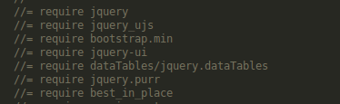
Rendering CSS and JS
For css files, include them as follows:
For js files, include them as follows:

Slide 17
Object Binding / Form Helpers
Object Binding
Form Fields
Form Tags
Helper’s
DateHelper

Slide 18
Object Binding
This module provides methods for generating container tags, such as div, for your record. This is the recommended way of creating a container for render your Active Record object, as it adds an appropriate class and id attributes to that container.
content_tag_for
Renders a container tag that relates to your Active Record Object.
For example, given @article is the object of Article class, you can do:
<%= content_tag_for(:tr, @article) do %>
<td><%= @article.title %></td>
<% end %>
This will generate this HTML output:
<tr id="article_1234" class="article">
<td>Hello World!</td>
</tr>

Slide 19
Form Fields
The core method of this helper, form_for, gives you the ability to create a form for a model instance; for example, let's say that you have a model Person and want to create a new instance of it:
# Note: a @person variable will have been created in the controller (e.g. @person = Person.new)
<%= form_for @person, url: {action: "create"} do |f| %>
<%= f.text_field :first_name %>
<%= f.text_field :last_name %>
<%= submit_tag 'Create' %>
<% end %>
The HTML generated for this would be:
<form action="/people/create" method="post">
<input id="person_first_name" name="person[first_name]" type="text" />
<input id="person_last_name" name="person[last_name]" type="text" />
<input name="commit" type="submit" value="Create" />
</form>

Slide 20
check_box
check_box("article", "validated")
# => <input type="checkbox" id="article_validated"
file_field
file_field(:user, :avatar)
# => <input type="file" id="user_avatar" name="user[avatar]" />
form_for
hidden_field
hidden_field(:user, :token)
# => <input type="hidden" id="user_token" name="user[token]" value="#{@user.token}" />
Label
label(:article, :title)
# => <label for="article_title">Title</label>
password_field
password_field(:login, :pass)
# => <input type="text" id="login_pass" name="login[pass]" value="#{@login.pass}" />
radio_button
radio_button("article", "category", "rails")
radio_button("article", "category", "java")
# => <input type="radio" id="article_category_rails" name="article[category]" value="rails" checked="checked" />
# <input type="radio" id="article_category_java" name="article[category]" value="java" />

Slide 21
text_area
text_area(:comment, :text, size: "20x30")
# => <textarea cols="20" rows="30" id="comment_text" name="comment[text]">
text_field
text_field(:article, :title)
# => <input type="text" id="article_title" name="article[title]" value="#{@article.title}" />
email_field
email_field(:user, :email)
# => <input type="email" id="user_email" name="user[email]" value="#{@user.email}" />
url_field
url_field(:user, :url)
# => <input type="url" id="user_url" name="user[url]" value="#{@user.url}" />

Slide 22
Form Tags
Provides a number of methods for creating form tags that don't rely on an Active Record object assigned to the template like FormHelper does. Instead, you provide the names and values manually.
check_box_tag
field_set_tag
file_field_tag
form_tag
hidden_field_tag
image_submit_tag
label_tag
password_field_tag
radio_button_tag
select_tag
submit_tag
text_area_tag
text_field_tag
email_field_tag
date_field_tag

Slide 23
Helper’s
We always remove the logic from the views.
Hence we tend use helper function which have the logic that is to be implemented.
We have an application.helper file which has helper functions that can be accessed by any of the views in the Project
Also we have individual helpers for specific views too.

Slide 24
Using Helper’s
<% if @person.age > 20 %>
<p> Hi Man </p>
<% else %>
<p> Hello Kid </p>
<% end %>
Now instead of implementing this logic on view we can write it in a helper and call that helper instead .See
In the helper : In the view now :
def is_adult?( age ) <% if @person.is_adult? %>
return true if age > 20 <p>Hi Man </p>
return false <% else %>
end <p>Hello Kid </p>

Slide 25
Date Helper
date_select
Returns a set of select tags (one for year, month, and day) pre-selected for accessing a specified date-based attribute.
date_select("article", "published_on")
datetime_select
Returns a set of select tags (one for year, month, day, hour, and minute) pre-selected for accessing a specified datetime-based attribute.
datetime_select("article", "published_on")
distance_of_time_in_words
Reports the approximate distance in time between two Time or Date objects or integers as seconds. Set include_seconds to true if you want more detailed approximations.
distance_of_time_in_words(Time.now, Time.now + 15.seconds) # => less than a minute
select_date
Returns a set of HTML select-tags (one for year, month, and day) pre-selected with the date provided.
# Generates a date select that defaults to the date provided (six days after today)
select_date(Time.today + 6.days)

Slide 26
select_datetime
Returns a set of HTML select-tags (one for year, month, day, hour, and minute) pre-selected with the datetime provided.
# Generates a datetime select that defaults to the datetime provided (four days after today)
select_datetime(Time.now + 4.days)
select_day
# Generates a select field for days that defaults to the day for the date provided
select_day(Time.today + 2.days)
select_hour
select_hour(Time.now + 6.hours)
select_minute
select_minute(Time.now + 6.hours)
select_month
select_month(Date.today)
select_second
select_second(Time.now + 16.minutes)

Slide 27


Thank You !!
It is time for questions !!

